Slide 1
WISHLIST PRODUCT COMPARISION
AVINASH
YOGESH
SHEK JAMAL
TARUN REDDY
PYTHON PROJECT

Slide 2
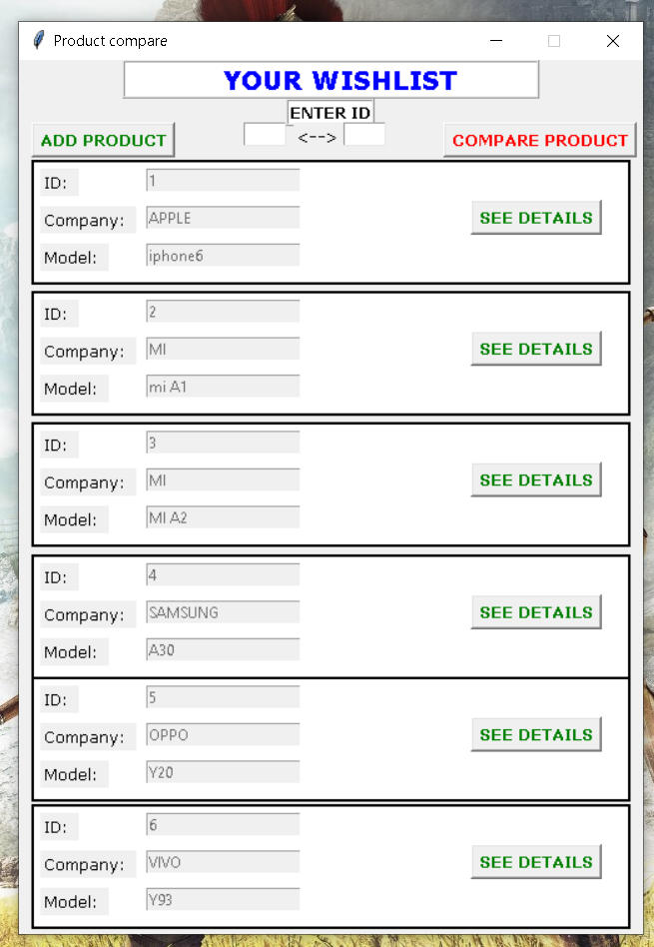
WISHLIST LANDING GUI
THIS IS THE MAIN PAGE HAVING ALL FUNCTIONALITY
*ADD PRODUCT
*COMPARE PRODUCT
*SEE DETAILS
*LOOK WISHLIST
All data is stored in sqlite3 database and fetched from that only.
by AVINASH

Slide 3
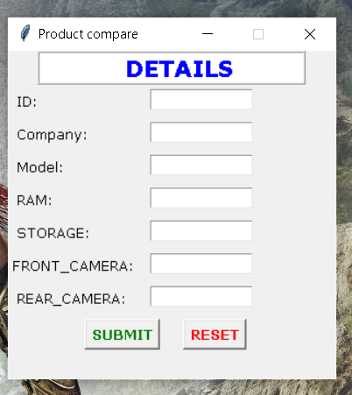
ENTERING PRODUCT DATA IN DATABSE from here data is stored in database using GUI and that data can be fetched anytime required for comparison BY YOGESH

Slide 4
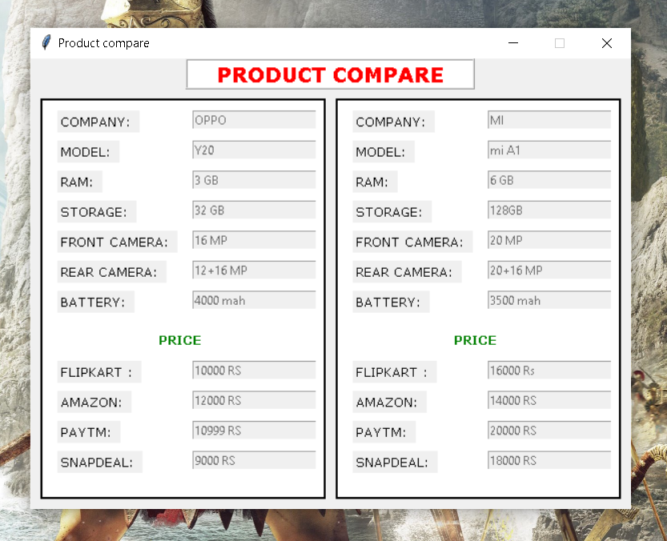
PRODUCT COMPARISION
PRODUCT COMPARISION IS DONE THROUGH THE UNIQUE PRODUCT ID ASSIGNED TO EACH PRODUCT AND ON ENTRY BOXES DATA FROM DATABASE IS PRESENTED.
BY AVINASH

Slide 5
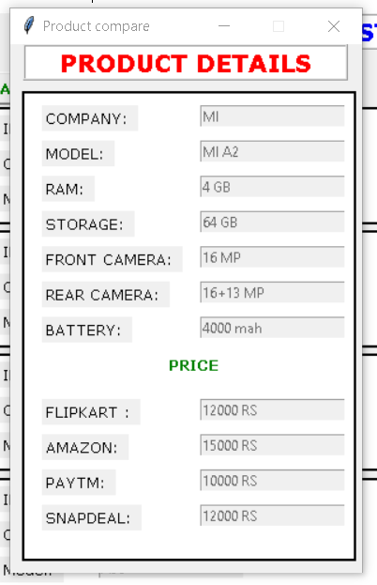
DETAILS OF PRODUCT
SPECIFIC DETAILS OF A PARTICULAR PRODUCT CAN BE PULLED FROM DATABASE IN A CLICK AND CAN BE VIEWED SEPERATLY.
BY YOGESH

